Slide 1

AIR QUALITY INDEX HIGH LEVEL DOCUMENT
The precise prediction of AQI and other atmospheric pollutant levels is crucial for policymakers to give early warning and develop control strategies.

Slide 2
CONTENTS
1. INDIAN AQI EQUATION
2. INDIAN CPCB AQI
3. ARCHITECTURE OF DATAFLOW
4. ANALYSIS REPORT
5. S02 LEVEL REPORT BY STATES
6. MODEL EVALUAVATION PERCENT
7. TOOLS USED
8. DEPLOYMENT SCREEN.
9. 1O TIPS FOR MAINTAIN GOOD AIR QUALITY INDEX

Slide 3
1. Indian equation for AQI:
The Indian AQI range differs from that of US-EPA. To calculate AQI, a minimum of three parameters should be taken out of which one must be either PM10 or PM2.5.
To calculate sub-indices, 16 hours of data is needed.
For example: If you wish to calculate AQI on the basis of PM2.5, CO, and ozone, calculate the sub-index for each parameter separately.
If the current concentration of PM2.5 is 110 ug/m3, then referring to AQI range as per Indian standards BPHi = 120, BPLo = 91, IHi = 300 and ILo = 201.
Putting the values in equation and solving:
Sub Index= [(300-201)/ (120-91)] (110-91) + 201 = 265.86
Similarly, for other parameters, the sub-index can be calculated and the worst sub-index shows the AQI.

Slide 4
Indian (CPCB) AQI:
According to the Indian Government (CPCB), Indian AQI range is from 0-500, from 0 being good and 500 being severe. There are eight major pollutants to be taken into account for AQI calculation, viz. particulate matter (PM 10 and PM 2.5), carbon monoxide (CO), ozone (O3), nitrogen dioxide (NO2), sulfur dioxide (SO2), ammonia (NH3), and lead (Pb). To calculate AQI, data for a minimum of three pollutants must be present, of which one should be either PM10 or PM2.5, AQI ranging from 0-500 has different concentrations for each pollutant and has health effects accordingly.
Indian AQI range & probable impacts:
0-50: This range defines air quality as good as it shows minimal or no impact on health.
51-100: This is a satisfactory air quality range and it can show effects such as breathing difficulty in sensitive groups.
101-200: The range shows moderate air quality with impacts such as breathing discomfort for children and elderly people, and people already suffering from lung disorders and heart disease.
201-300: AQI falling in this range communicates that the air quality is poor and shows health effects on people when exposed for the long term. People already suffering from heart diseases can experience discomfort from short exposure.
301-400: This range shows very poor air quality and causes respiratory illness for a longer duration of exposure.
401-500: This is the severe range of AQI causing health impacts to normal and diseased people. It also causes severe health impacts on sensitive groups.

Slide 5
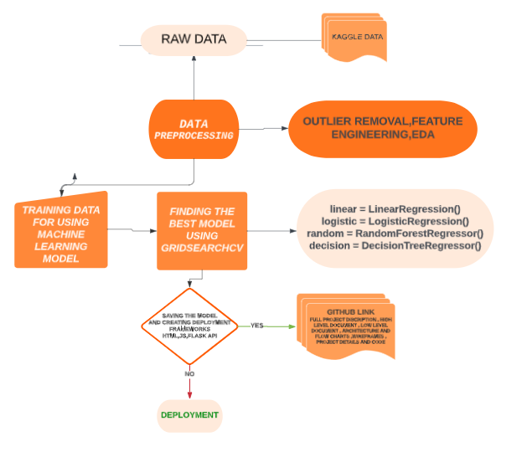
ARCHITECTURE OF DATAFLOW

Slide 6
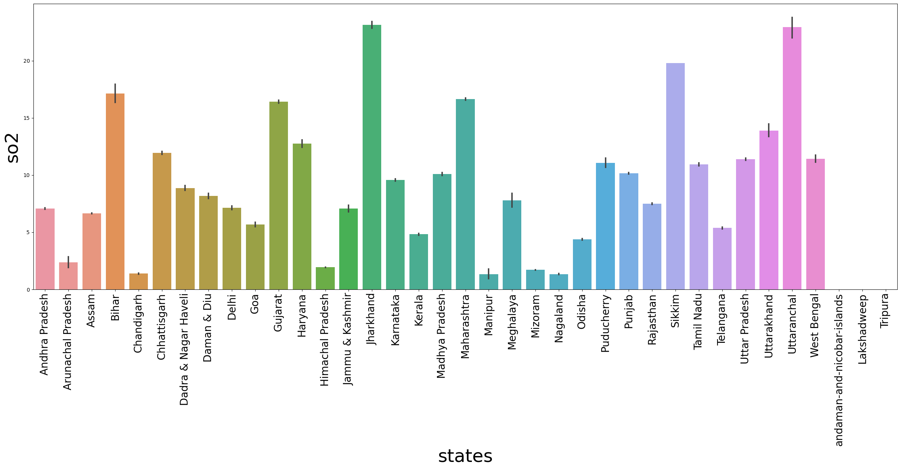
ANALYSIS REPORT

Slide 7
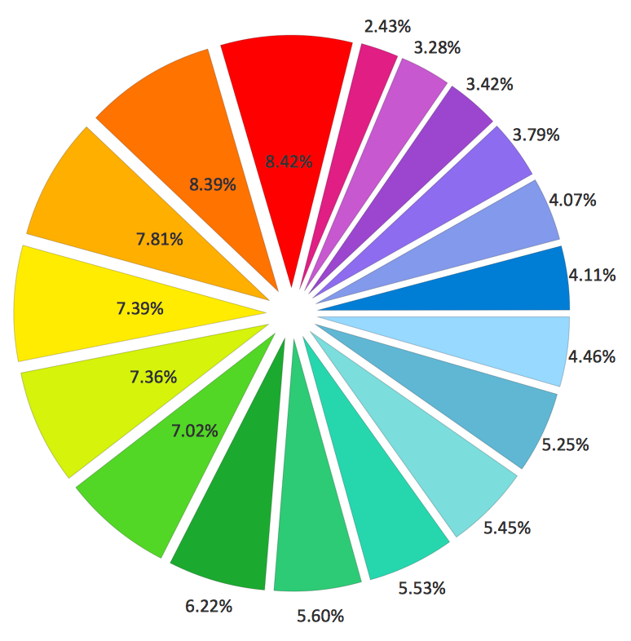
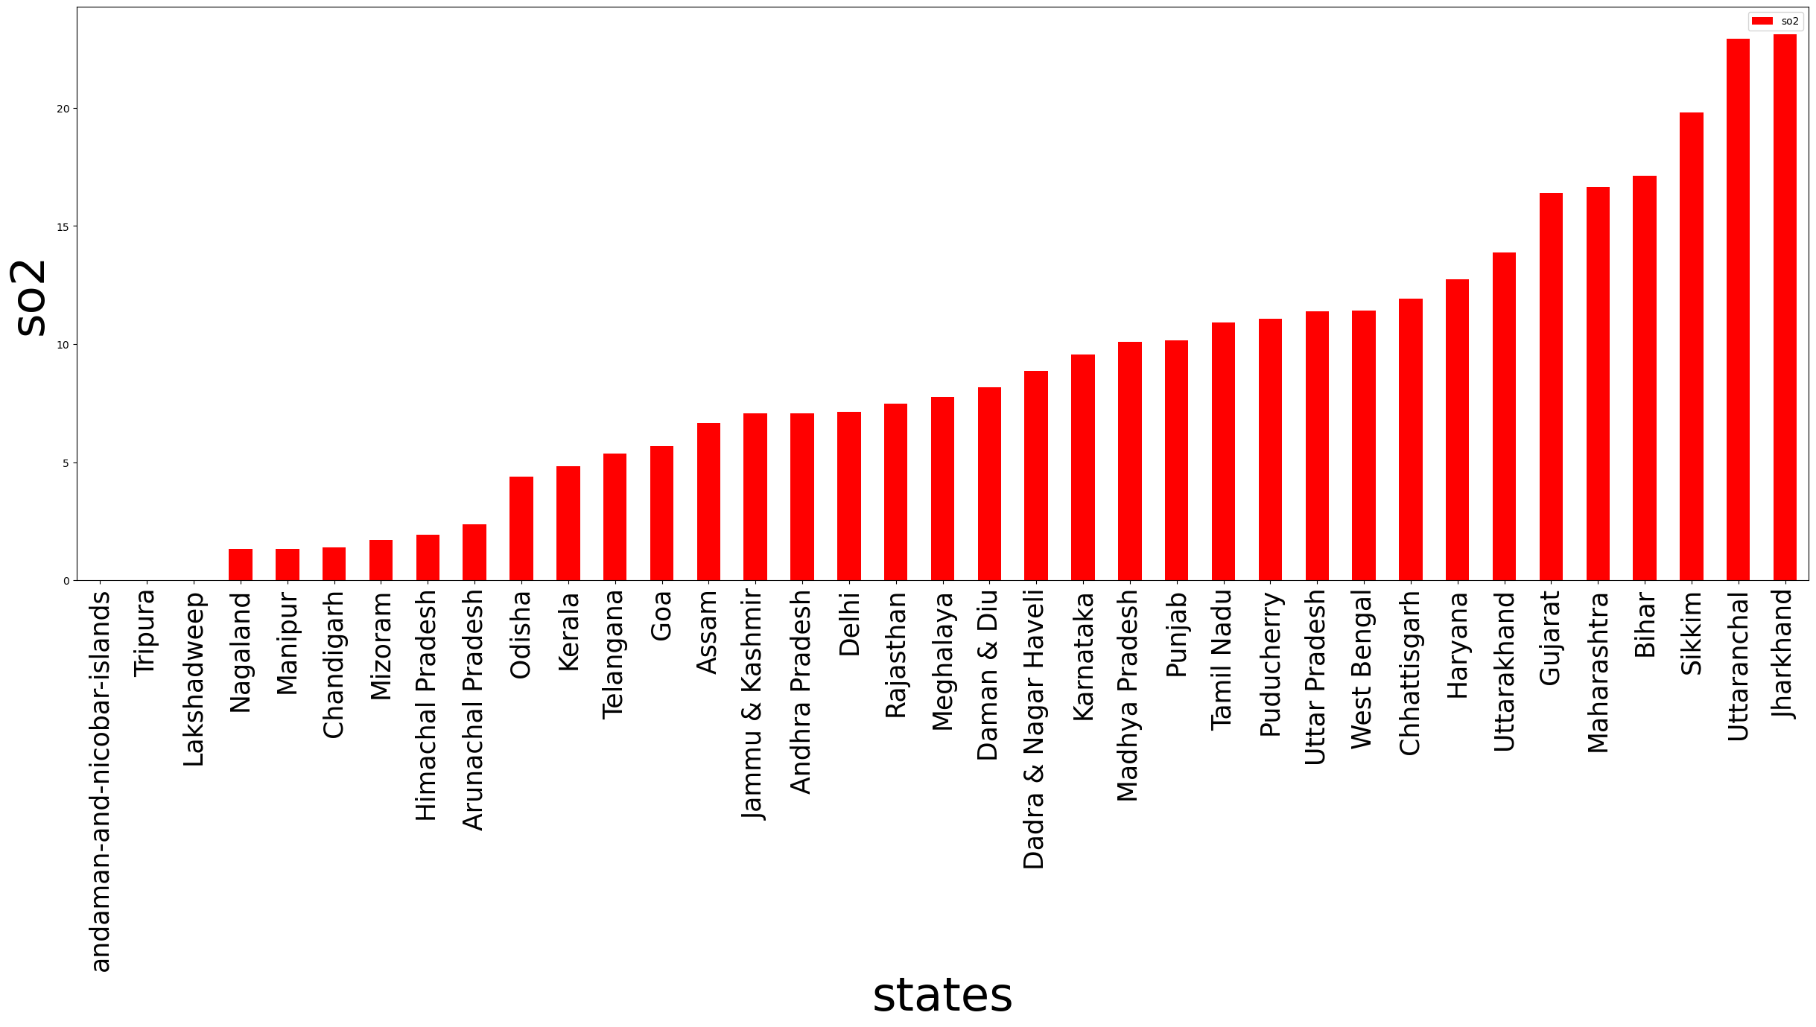
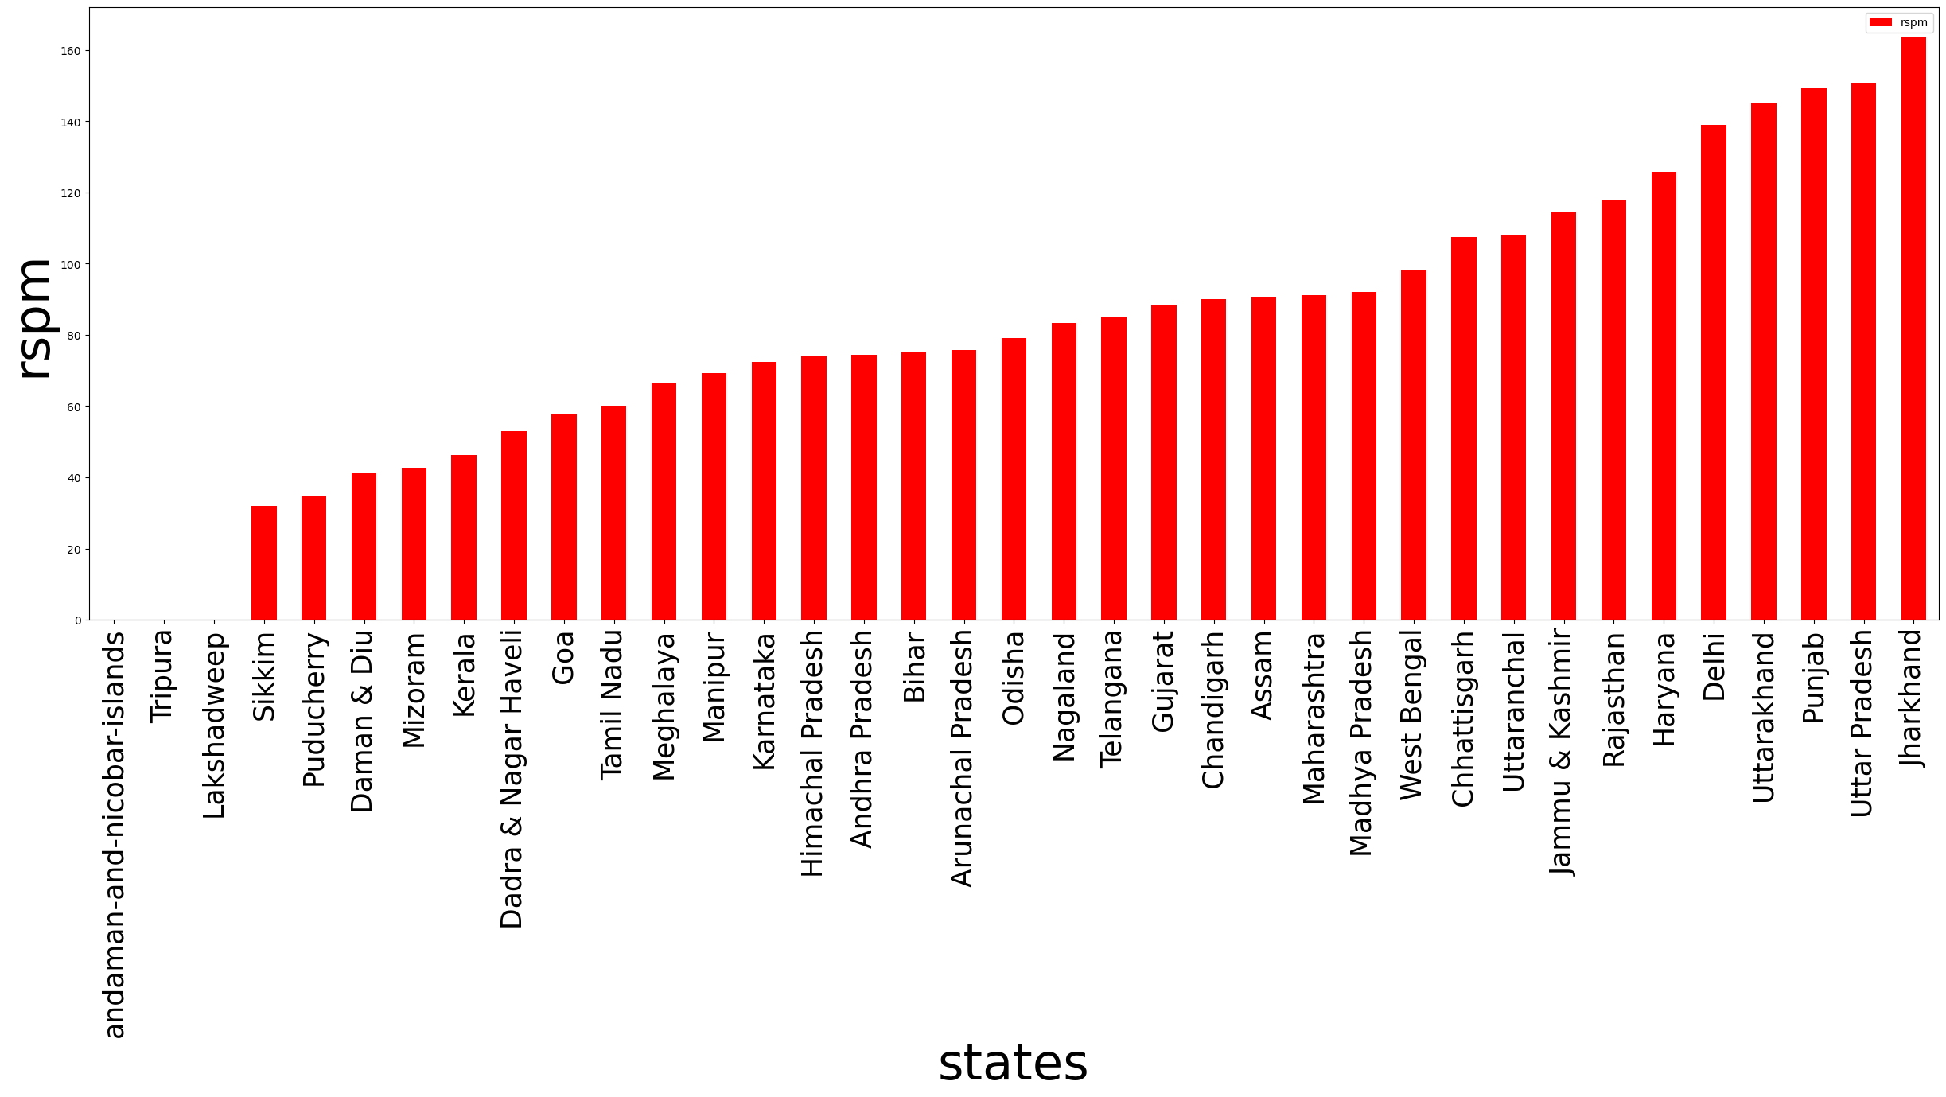
SO2 LEVEL REPORT BY STATES

Slide 8
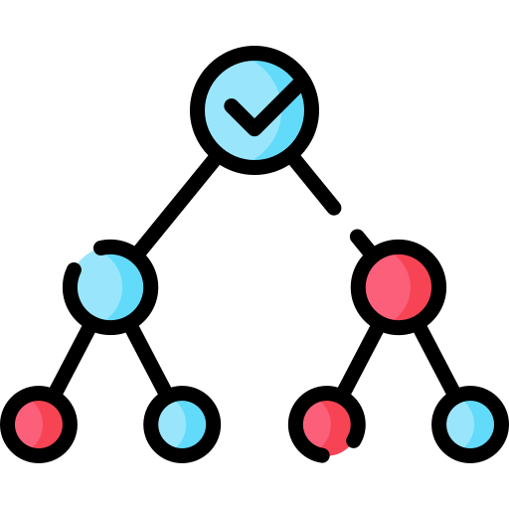
MODEL EVALUATION PERCENT
DECISION TREE: 99.93%
RANDOM FOREST:99.93%
LINEAR REGRESSION:88.34%
WHY DECISION TREE ?
Are simple to understand and interpret. People are able to understand decision tree models after a brief explanation.
Help determine worst, best, and expected values for different scenarios.

Slide 9

TOOLS USED
PYTHON10
JUPYTER NOTEBOOK
ANACONDA
VISUALSTUDIO
PANDAS
NUMPY
MATPLOTLIB
SEABORN
SKLEARN
JOBLIB
FLASK API
HTML
JAVASCRIPT
CSS

Slide 10
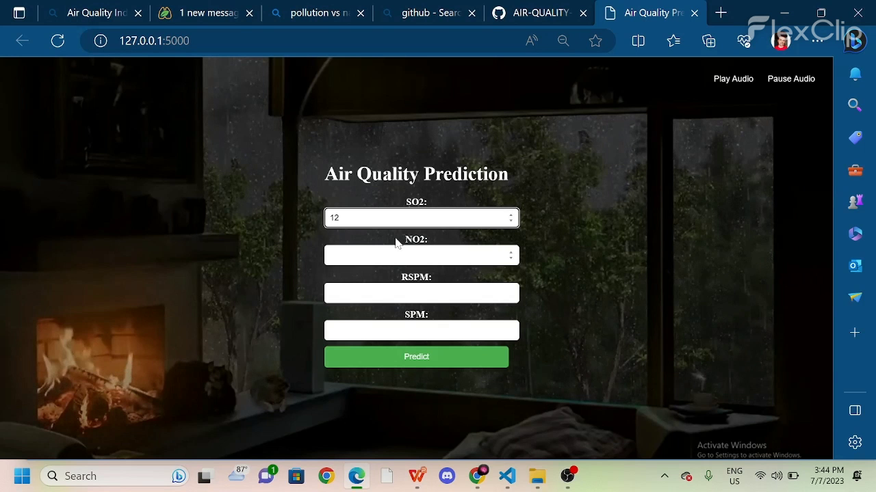
USER FRIENDLY DEPLOYMENT

Slide 11
1O TIPS FOR MAINTAIN GOOD AIR QUALITY INDEX
1. Limit the frequent use of vehicles
2. Quit smoking tobacco
3. Do not use and burn plastics
4. Minimize waste production
5. Buys things of use as it will reduce waste.
6. Minimize the use of air conditioners, refrigerants, and other coolants.
7. Follow the 5 R’s: Reuse, Reduce, Recycle, Repair, and Refuse.
8. Opt for public transport
9. Switch to renewable energy such as solar and wind energy
10. Get your kitchen chimneys clean regularly

